Slide 1
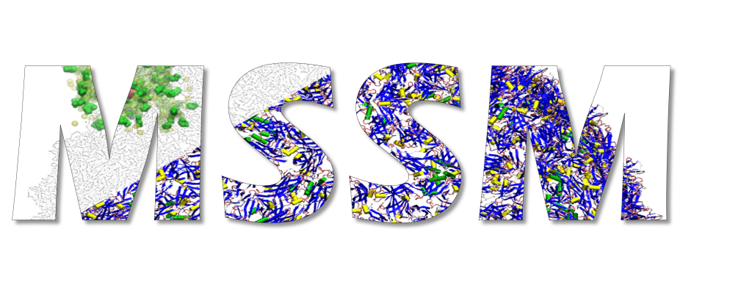
Genetic Algorithms in Python
Rogério Póvoa
28/03/2018

Slide 2
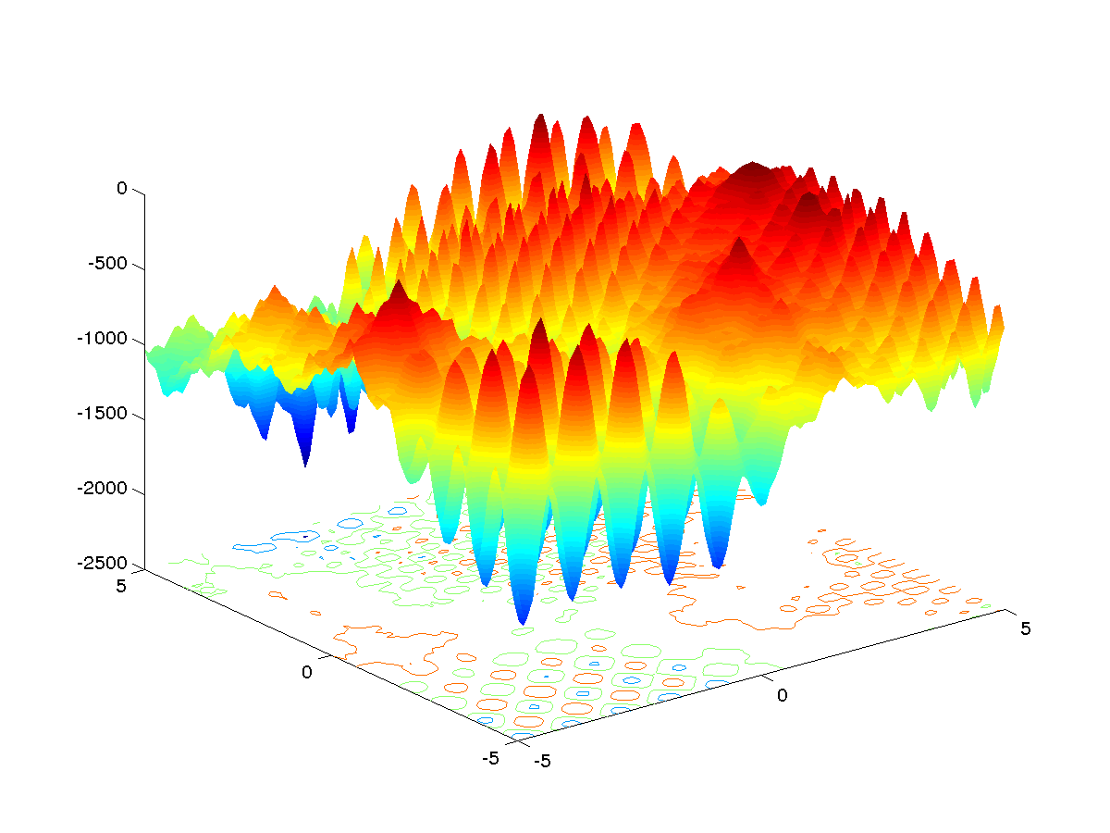
Optimization
Stochastic

Slide 3
Evolutionary Computation
Evolutionary Computation
late 1950s
Evolutionary Programming
1966
Evolution Strategies
1973
Genetic Algorithm
1975
Genetic Programming
1992

Slide 4
Evolutionary Computation
Evolutionary Computation
late 1950s
Evolutionary Programming
1966
Evolution Strategies
1973
Genetic Algorithm
1975
Genetic Programming
1992

Slide 5
Genetic Algorithms
START
Initial Population
Evaluation
Selection
Genetic Operators
Stop Criterium
END

Slide 6
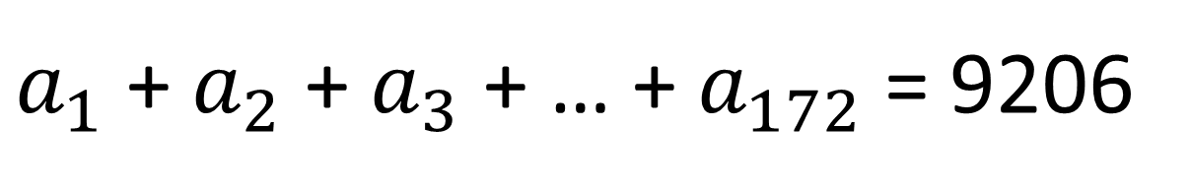
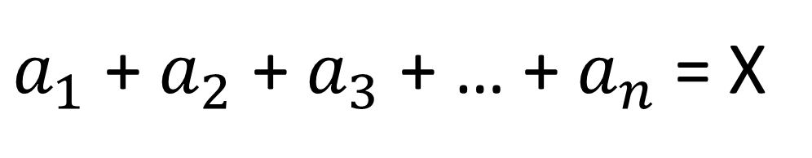
$a_{1}$ + $a_{2}$ + $a_{3}$ + … + $a_{n}$ = X
34 +33 + 33 = 100
$a_{1}$ + $a_{2}$ + $a_{3}$ + … + $a_{172}$ = 9206

Slide 7
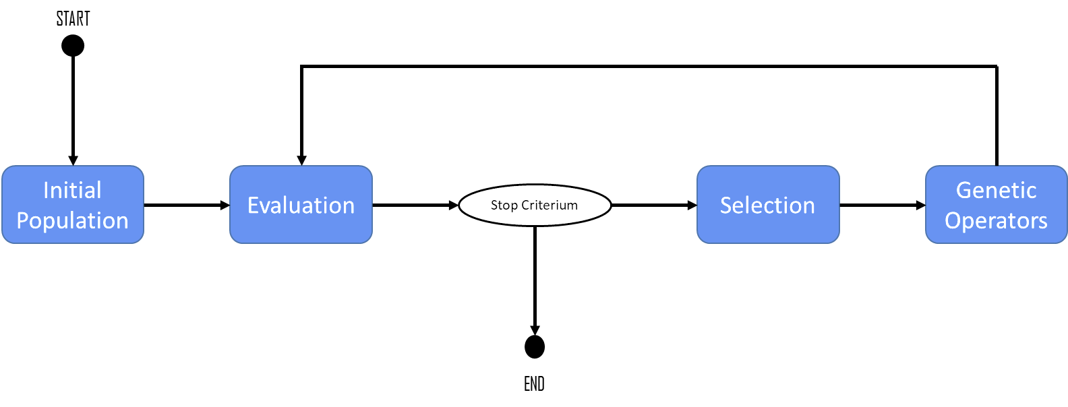
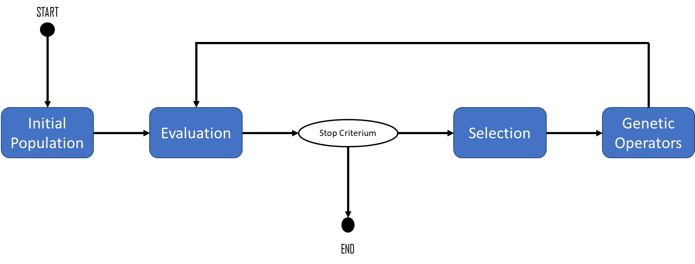
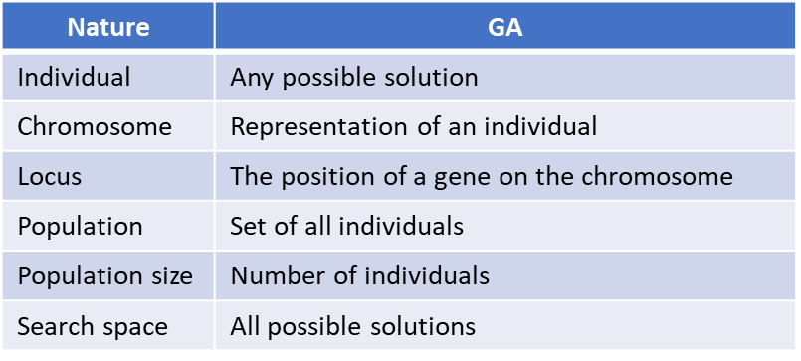
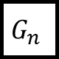
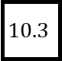

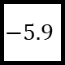
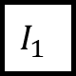
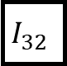
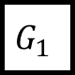
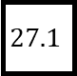
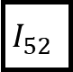


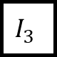
Representation
Individual
$$G_{1}$$
$$G_{1}$$
$$G_{1}$$
$$…$$
$$G_{n}$$
Binary
$$1$$
$$1$$
$$0$$
$$1$$
$$0$$
Real Numbers
$$27.1$$
$$−5.9$$
$$10.3$$
Permutation of elements
$$I_{3}$$
$$I_{52}$$
$$I_{32}$$
$$I_{1}$$
Nature | GA
Individual | Any possible solution
Chromosome | Representation of an individual
Locus | The position of a gene on the chromosome
Population | Set of all individuals
Population size | Number of individuals
Search space | All possible solutions

Slide 8
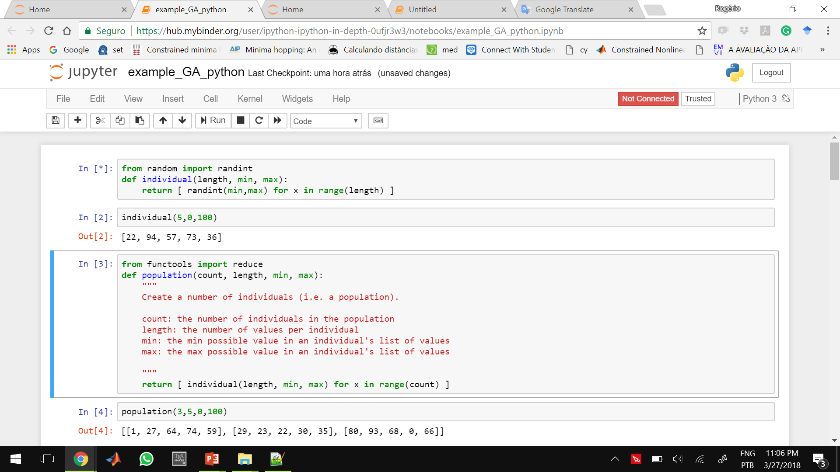
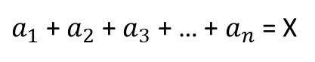
Representation
individual
List of length numbers within an interval [min, max].
*Library: randint from random
$a_{1}$ + $a_{2}$ + $a_{3}$ + … + $a_{n}$ = X

Slide 9
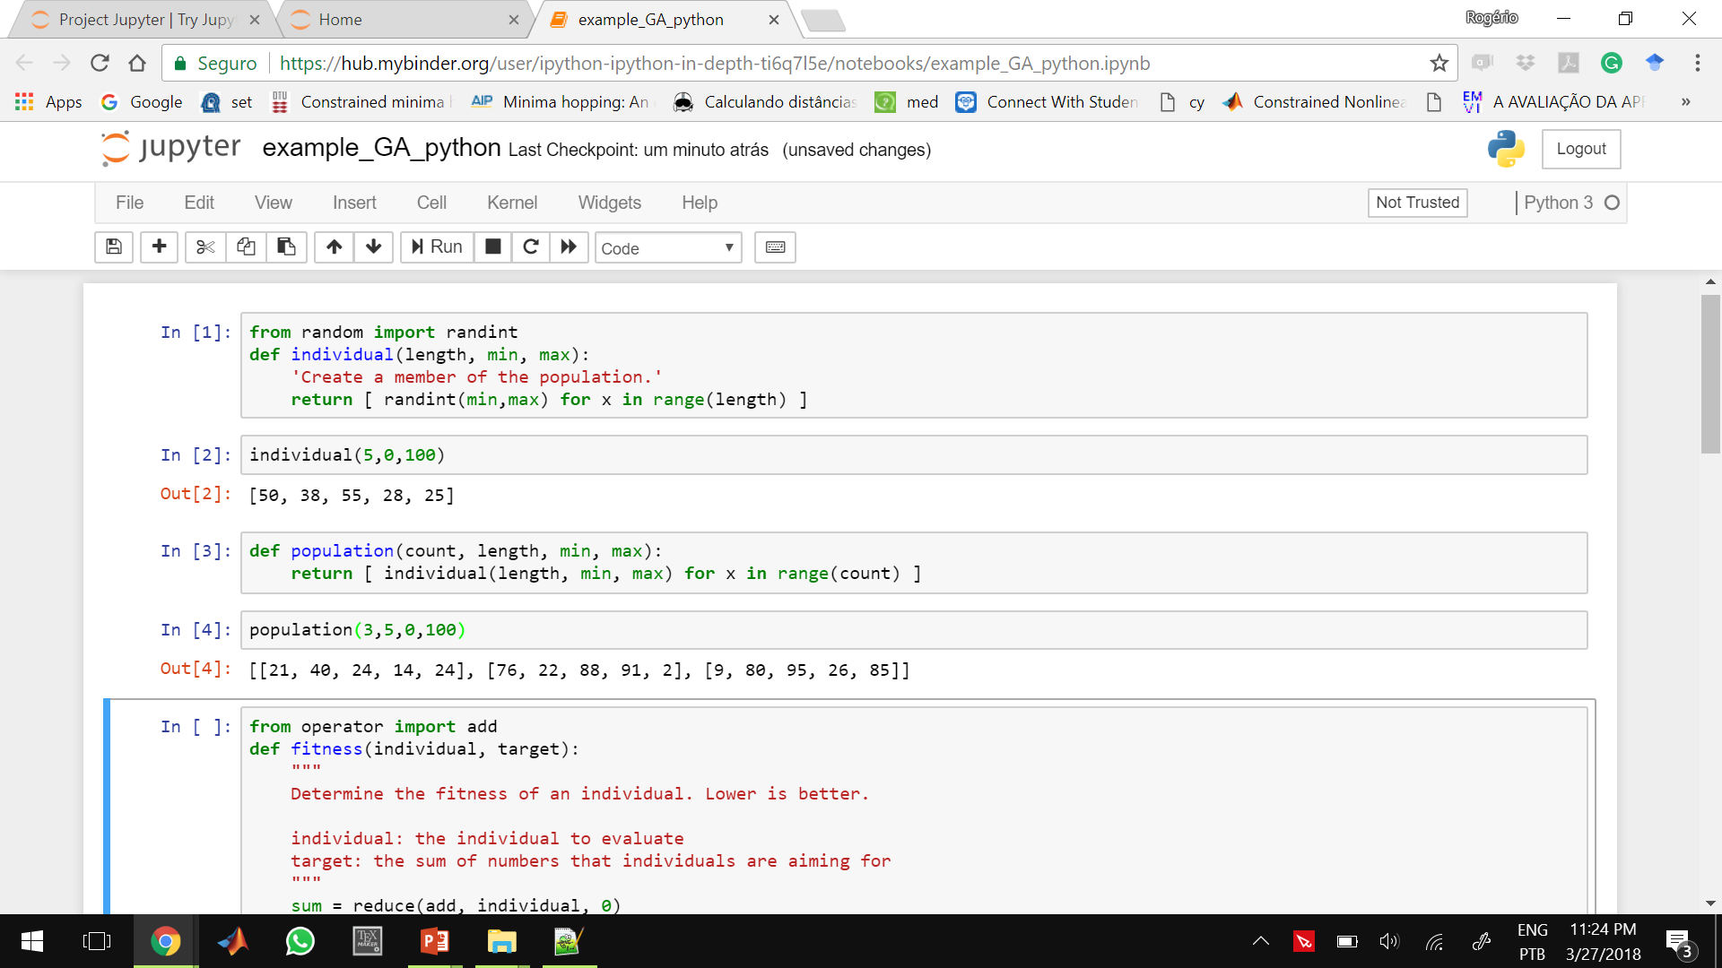
Representation
population
With count individuals.
*Individual(length,min,max)
$a_{1}$ + $a_{2}$ + $a_{3}$ + … + $a_{n}$ = X

Slide 10
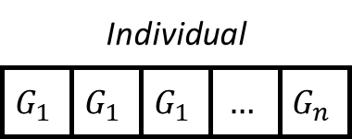

Evaluation
Objective Function
Fitness

Slide 11
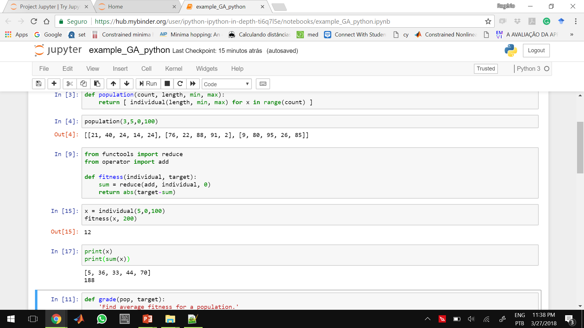
Evaluation
fitness
A function of the distance between the sum of the numbers of an individual and a target number.
*reduce from functools
*add from operator
$a_{1}$ + $a_{2}$ + $a_{3}$ + … + $a_{n}$ = X

Slide 12
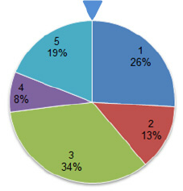
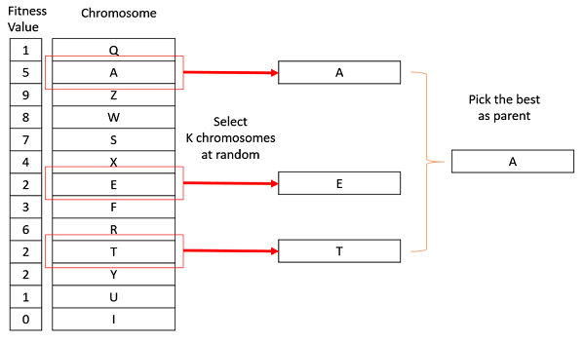
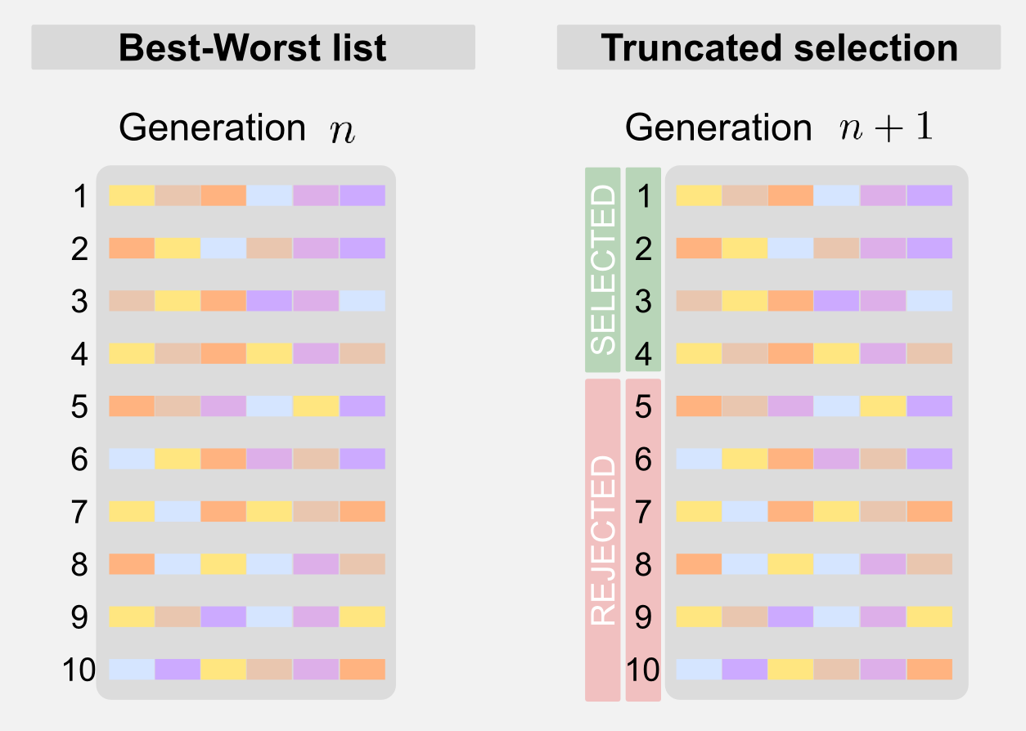
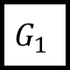
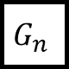

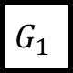
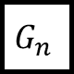

Selection
population
Fitter individuals are more likely to be selected
$$G_{1}$$
$$G_{1}$$
$$G_{1}$$
$$…$$
$$G_{n}$$
$$G_{1}$$
$$G_{1}$$
$$G_{1}$$
$$…$$
$$G_{n}$$

Slide 13
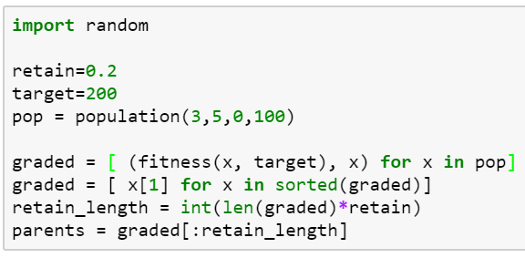
Selection
Truncation selection takes a proportion of individuals.

Slide 14
Selection
Tournament selection

Slide 15
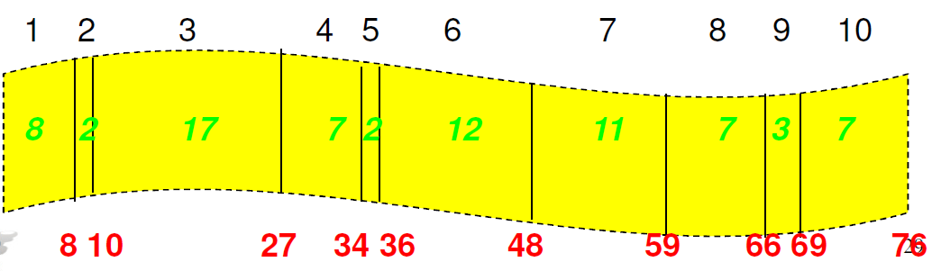
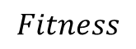
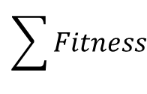
Selection
Individual
1 | 2 | 3 | 4 | 5 | 6 | 7 | 8 | 9 | 10
8 | 2 | 17 | 7 | 2 | 12 | 11 | 7 | 3 | 7
8 | 10 | 27 | 34 | 36 | 48 | 59 | 66 | 69 | 76
$$Fitness$$
$$\sum{Fitness}$$
Random Number
23 | 49 | 76 | 13 | 1 | 27 | 57
3 | 7 | 10 | 3 | 1 | 3 | 7
Selected Individual

Slide 16
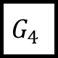
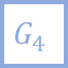
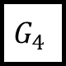
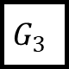
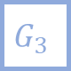
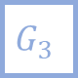

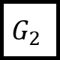
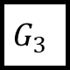
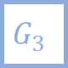
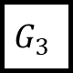
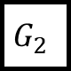

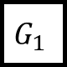
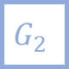
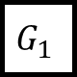

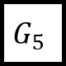
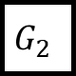
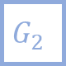
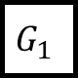



















Genetic Operators
Sigle-point crossover
$$G_{1}$$
$$G_{2}$$
$$G_{3}$$
$$G_{4}$$
$$G_{5}$$
$$G_{1}$$
$$G_{2}$$
$$G_{3}$$
$$G_{4}$$
$$G_{5}$$
$$G_{1}$$
$$G_{2}$$
$$G_{3}$$
$$G_{4}$$
$$G_{5}$$
$$G_{1}$$
$$G_{2}$$
$$G_{3}$$
$$G_{4}$$
$$G_{5}$$
Two-point crossover
Crossover
$$G_{1}$$
$$G_{2}$$
$$G_{3}$$
$$G_{4}$$
$$G_{5}$$
$$G_{1}$$
$$G_{2}$$
$$G_{3}$$
$$G_{4}$$
$$G_{5}$$
$$G_{1}$$
$$G_{2}$$
$$G_{3}$$
$$G_{4}$$
$$G_{5}$$
$$G_{1}$$
$$G_{2}$$
$$G_{3}$$
$$G_{4}$$
$$G_{5}$$

Slide 17







Genetic Operators
Uniform crossover
$$G_{1}$$
$$G_{2}$$
$$G_{3}$$
$$G_{4}$$
$$G_{5}$$
$$G_{1}$$
$$G_{2}$$
$$G_{3}$$
$$G_{4}$$
$$G_{5}$$
$$G_{1}$$
$$G_{2}$$
$$G_{3}$$
$$G_{4}$$
$$G_{5}$$
$$G_{1}$$
$$G_{2}$$
$$G_{3}$$
$$G_{4}$$
$$G_{5}$$
Arithmetic crossover:
Crossover
$${I1}_{G_{n}}=a {P1}_{G_{n}}+(1−a) {P2}_{G_{n}}$$
$$a∈[0,1]$$
$${I2}_{G_{n}}=a {P2}_{G_{n}}+(1−a) {P1}_{G_{n}}$$

Slide 18


Genetic Operators

Slide 19



Genetic Operators

Slide 20











Genetic Operators
$$G_{1}$$
$$G_{2}$$
$$G_{3}$$
$$G_{4}$$
$$G_{5}$$
$$G_{1}$$
$$G_{2}$$
$$G_{3}$$
$$G_{4}$$
$$G_{5}$$
Mutation

Slide 21

$a_{1}$ + $a_{2}$ + $a_{3}$ + … + $a_{n}$ = X
Representation
Evaluation

Slide 22


$a_{1}$ + $a_{2}$ + $a_{3}$ + … + $a_{n}$ = X
Selection:
$$⋮$$

Slide 23

$a_{1}$ + $a_{2}$ + $a_{3}$ + … + $a_{n}$ = X
Crossover:
$$⋮$$
$$⋮$$

Slide 24
$a_{1}$ + $a_{2}$ + $a_{3}$ + … + $a_{n}$ = X
Mutation:
$$⋮$$

Slide 25



$a_{1}$ + $a_{2}$ + $a_{3}$ + … + $a_{n}$ = X

Slide 26



$a_{1}$ + $a_{2}$ + $a_{3}$ + … + $a_{n}$ = X

Slide 27



Slide 28






OneMax Problem
$$0$$
$$0$$
$$1$$
$$…$$
$$0$$
$$1$$
$$1$$
$$1$$
$$…$$
$$1$$

Slide 29

Fitness

Slide 30


Representation
Individual
- List of Floats -

Slide 31

Representation
Individual
- Permutation -

Slide 32

Evaluation

Slide 33


Selection
Duplication:

Slide 34


Genetic Operators

Slide 35

Genetic Operators

Slide 36
OneMax Problem
$$0$$
$$0$$
$$1$$
$$…$$
$$0$$
$$1$$
$$1$$
$$1$$
$$…$$
$$1$$

Slide 37

OneMax Problem
- complete source -
$$0$$
$$0$$
$$1$$
$$…$$
$$0$$
$$1$$
$$1$$
$$1$$
$$…$$
$$1$$

Slide 38


OneMax Problem
- complete source -
$$0$$
$$0$$
$$1$$
$$…$$
$$0$$
$$1$$
$$1$$
$$1$$
$$…$$
$$1$$

Slide 39
OneMax Problem
$$0$$
$$0$$
$$1$$
$$…$$
$$0$$
$$1$$
$$1$$
$$1$$
$$…$$
$$1$$

Slide 40

Title | Genetic Algorithms + Data Structures = Evolution Programs Artificial intelligence
Author | Zbigniew Michalewicz
Edition | illustrated, reprint
Publisher | Springer Science & Business Media, 1996
ISBN | 3540606769, 9783540606765
Length | 387 pages

Slide 41


github.com/deap/deap
esa.github.io/pygmo/
deap.readthedocs.io

Slide 42



gecco-2018.sigevo.org
ecomp.poli.br/~wcci2018/

